Slide 1
Project DECServer
An Asynchronous Autograding Server with Simulation
Irshad Khan | 23m0824
Suchit Meshram | 23m0814

Slide 2
Overall coding choices
C++
We began the project using C till version 3 . However, as we progressed, we recognized that C++ significantly has better string handling and STL Libraries(eg Maps ,Queues used in version 4). Because of this c++ become our preferred choice.

Slide 3
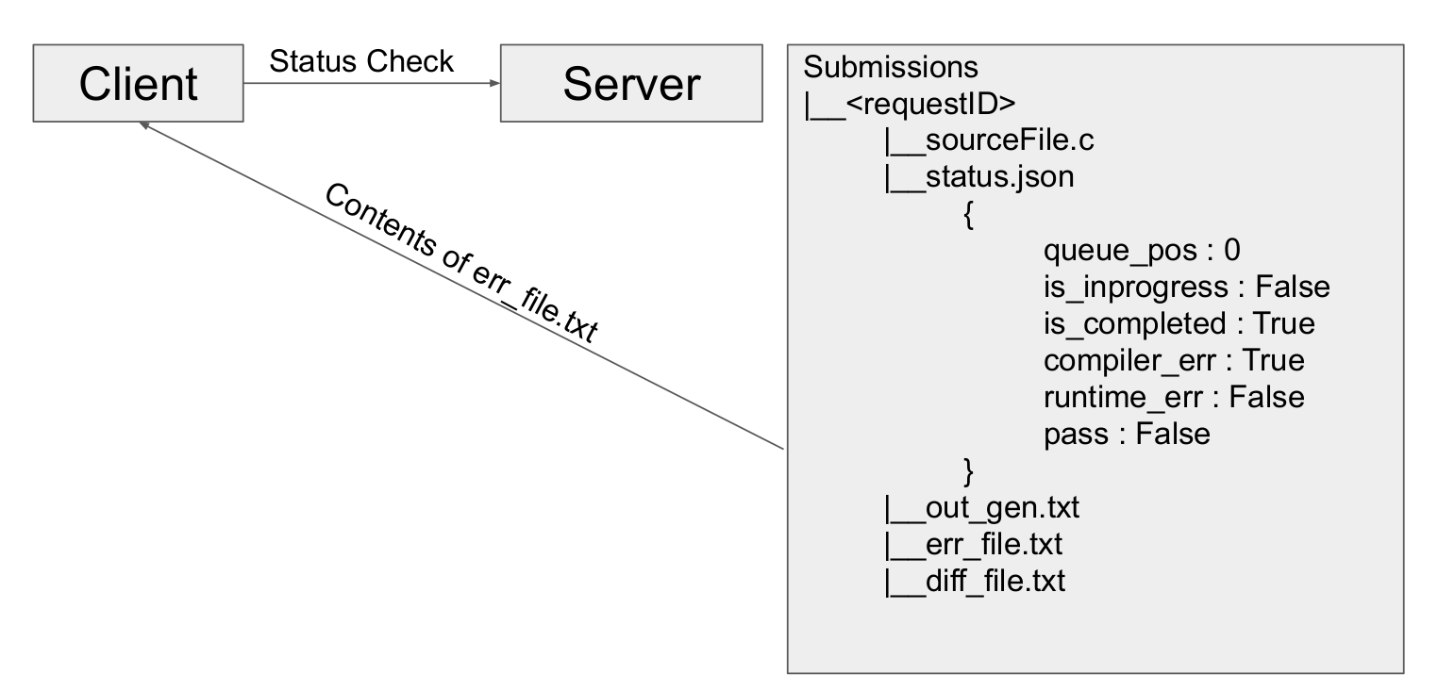
Asynchronous application design

Slide 4
When a client send a new request
./submit new <ip:port> <sourceFile>
We will generate a unique request ID using unix timestamp.
In submissions folder, we will create a folder named same as request ID.
In that folder, we will store the source file sent by the client and create status.json file which will have fields queue_pos, is_inprogress, is_completed.
We will store request ID in the queue for thread to process it further.
We will return request ID to the client for future requests.
( ./submit status <ip:port> <requestID> )

Slide 5
After client submits the request
Server will send request ID from the queue to the threads in order to complete the requests.
For a request ID it will search for a folder named with that request ID in submission directory.
In status.json file, it will update the is_inprogress field to true and also update the queue_pos to zero.
During this time, if client checks the status of its request ID we will check the is_inprogress and is_completed field in status.json file.
is_inprogress=True & is_completed=False then send response to client ‘Your grading request ID <requestID> has been accepted and is currently being processed.’

Slide 6
When client checks status of request (Using request ID)
./submit status <ip:port> requestId
Server will send requests to separate thread pool designated for this purpose.
If request is in queue server will update will check position of request in the queue and send response ‘Your grading request ID <requestID> has been accepted. It is currently at position <queuePos> in the queue.
If Not in queue, thread will check the folder named with request ID and checks the fields in status.json.
If is_completed=True then we will check compile_err :<T/F>, runtime_err : <T/F>, and pass :<T/F> fields and whichever field is true, we will send response according to that field.
If wrong request ID is sent by client then, we will check if folder named with that request ID exists. If not found then send response to client ‘Grading request <requestID> not found. Please check and resend your request ID or re-send your original grading request.’

Slide 7
Design choices
RequestId(Token) Was generated using Timestamp + thread_id to get unique.
Unbounded Queue was used to store client request.We stored Token in the queue before return response token to client.
Map was used to store status fields in status.txt .Where status .txt is present in directory same as token_id.
Results of particular client is stored in ./Submissions/<token_id>/*
When client checks for status along with its token ,status.txt fields are checked and based on that correct output files content is send to client .
Currently Server is not resilient to reboots ,client needs to submit requests again

Slide 8
Performance Analysis
During this analysis we have kept the parameters as follows.
Load Testing starts from 1 → 100 clients
Number of loops: 10
Sleep Time: 1sec
Threads :4

Slide 9
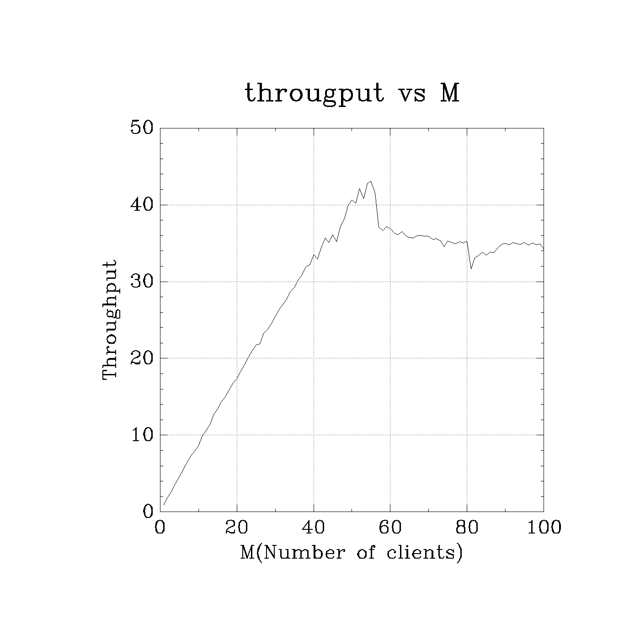
Throughput
For 4 cores and 4 threads ,with each request taking around 100ms we achieve around 40 request/sec.

Slide 10
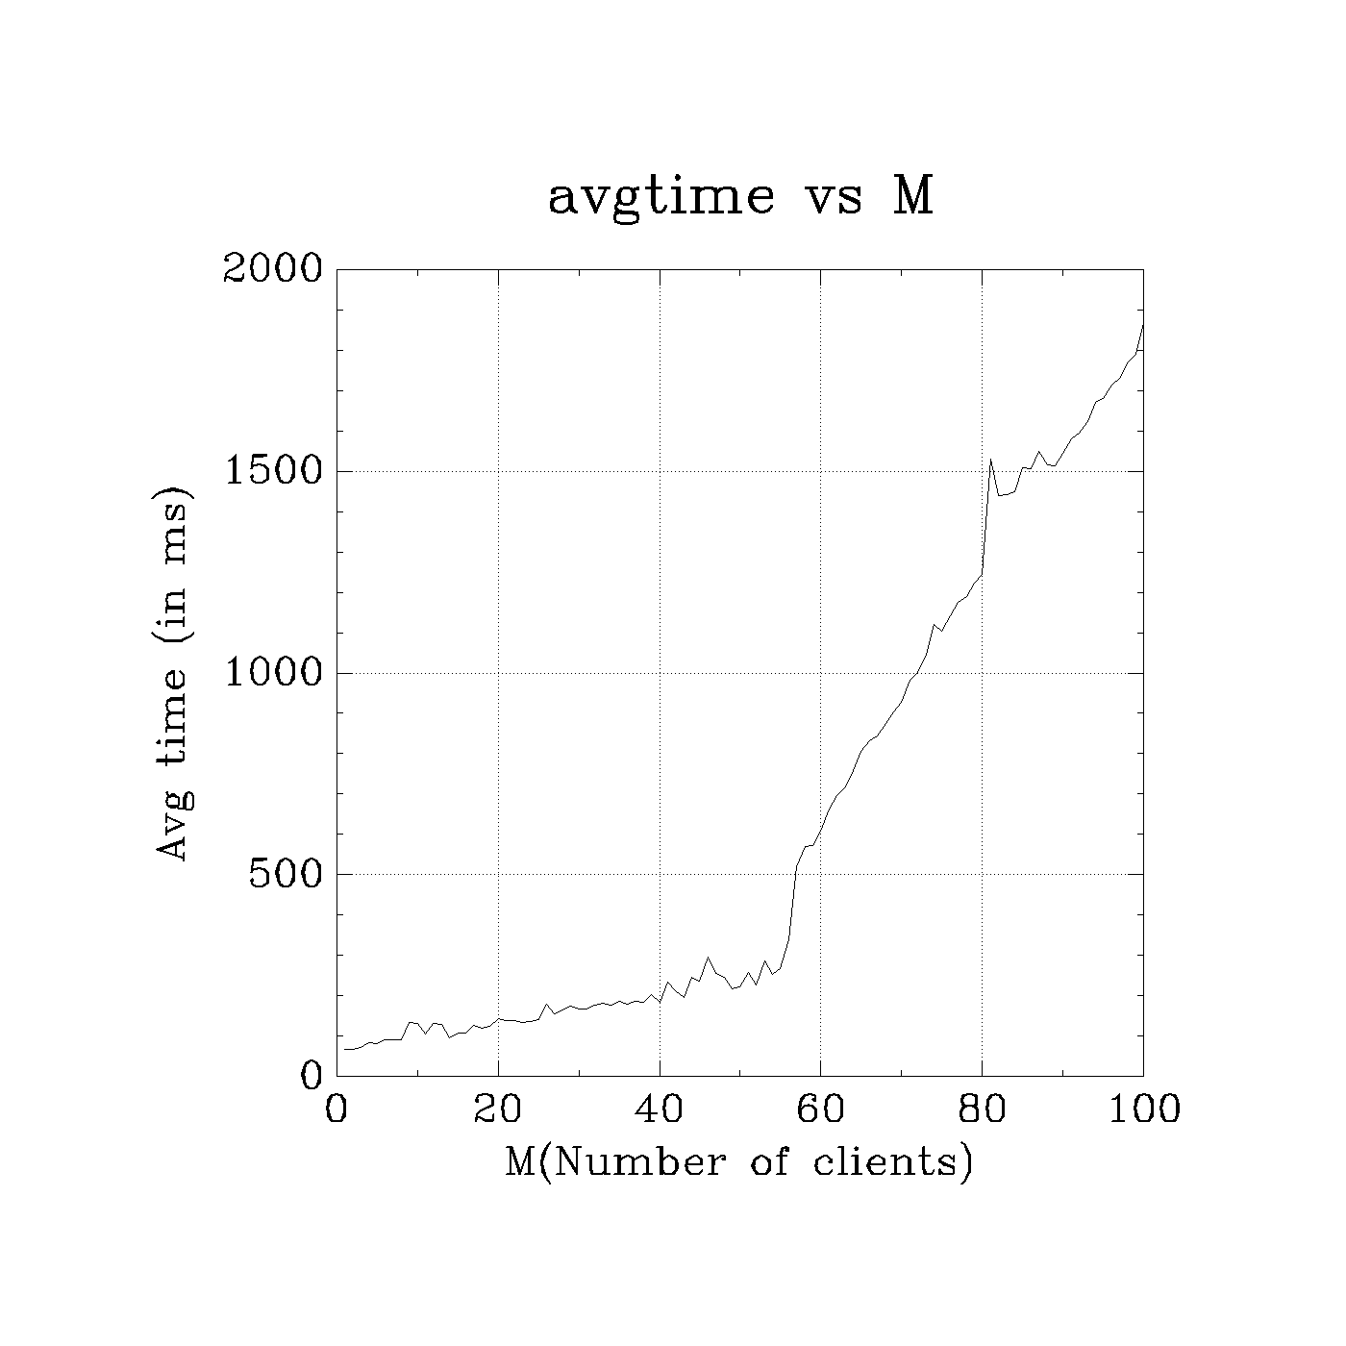
Average Response Time taken
ThinkT=1,throuput taken from throughput graph
Rt=(no.of clients/throughput)-1/thinkT
Rt(M=45)=(45/35)-1 =0.28s =280 ms
Rt(M=80)=(80/32)-1 =1.5s =1500 ms

Slide 11
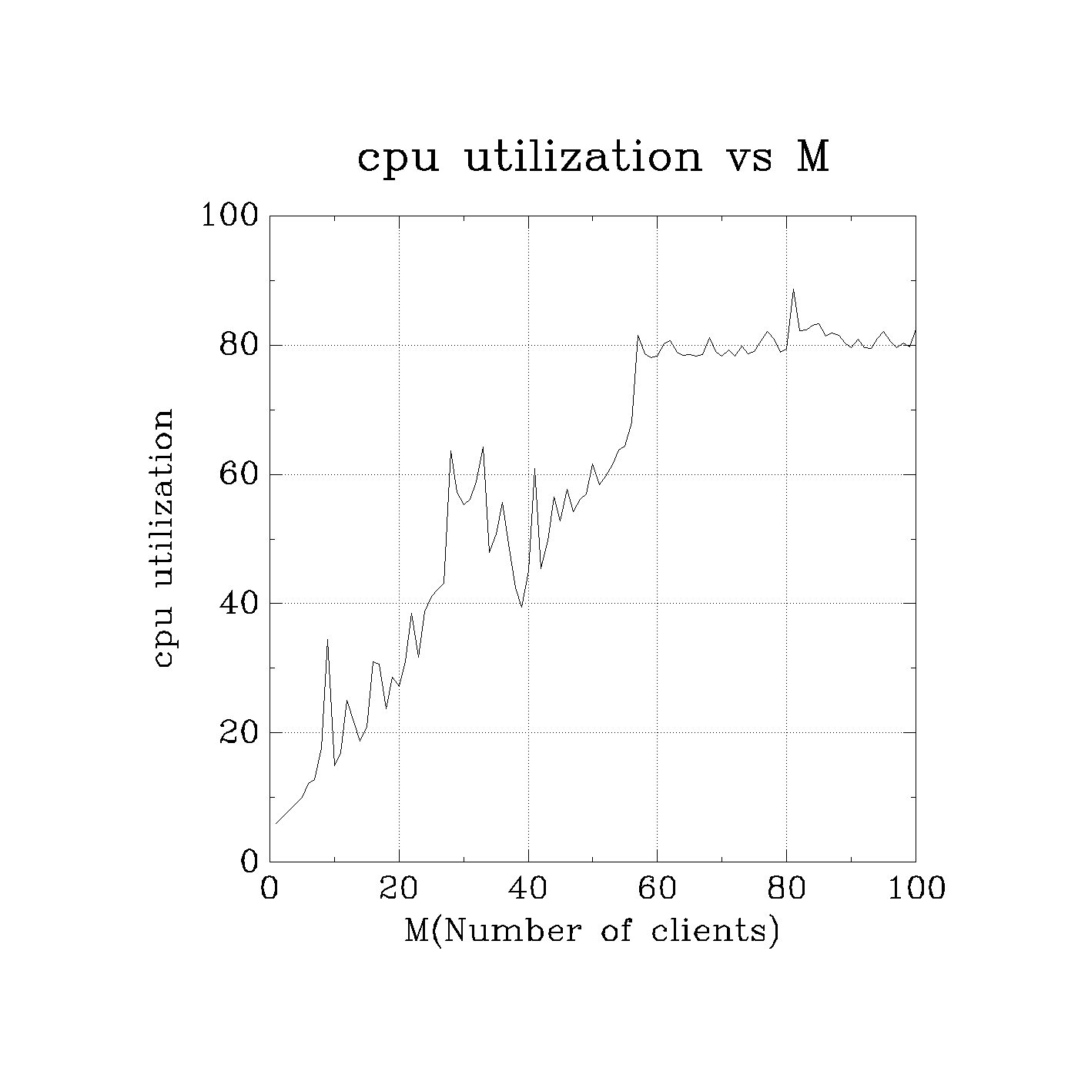
Average CPU Utilization
As Number of clients increases,cpu utilization increases.

Slide 12
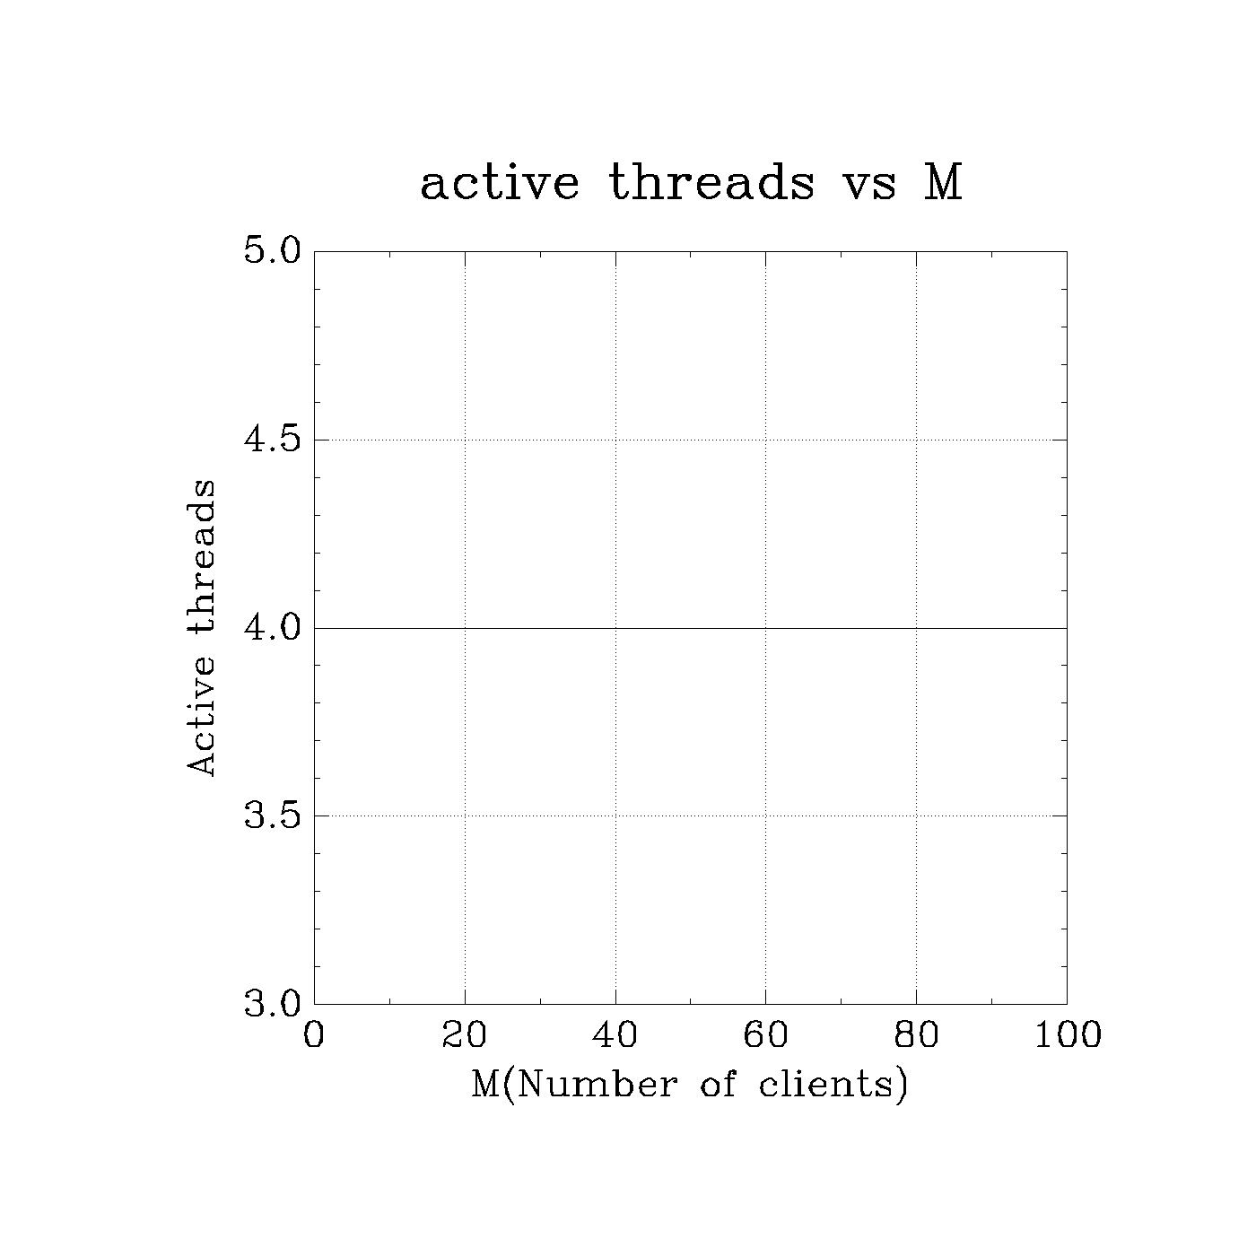
Average Number of Threads
We have thread pool of size 4

